Slide 1
Android Training: Day 1

Slide 2

Agenda
Introduction to Android Studio
Android Studio Overview
Building and Running the App
Managing Project Overview
Important files
Android Project Structure Overview
Configuring Gradle Builds

Slide 3
Agenda
Android is an operating system for mobile phones and tablets, in much the same way that PCs run Microsoft Windows as their operating system. It's maintained by Google, and comes in a few different versions.
Google maintains an open-source operating system named Android.
It's got all the low-level "stuff" as well as the needed middleware to power and use an electronic device, and it is freely given away to anyone who wants to grab the code and build the operating system from it.
There is even a full application framework included, so third-party apps can be built and installed, then made available for the user to run as they like.
The "proper" name for this is the Android Open Source Project, and this is what people mean when they say things like Android is open and free.

Slide 4
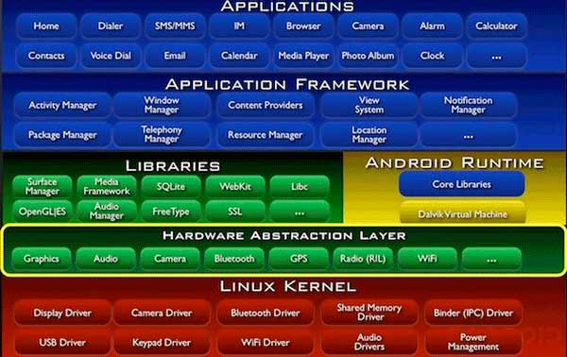
Architecture

Slide 5
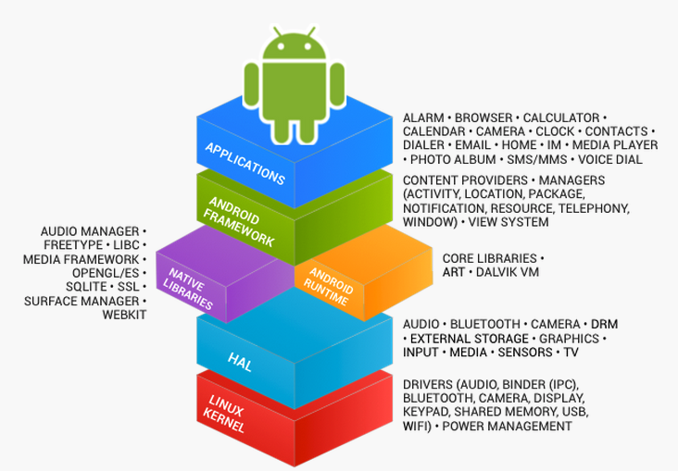
What is Android?

Slide 6
Android Studio Overview
Android Studio is the official IDE for Android application development, based on IntelliJ IDEA. On top of the capabilities you expect from IntelliJ, Android Studio offers:
Flexible Gradle-based build system
Build variants and multiple apk file generation
Code templates to help you build common app features
Rich layout editor with support for drag and drop theme editing
lint tools to catch performance, usability, version compatibility, and other problems
ProGuard and app-signing capabilities
Built-in support for Google Cloud Platform, making it easy to integrate Google Cloud Messaging and App Engine
.

Slide 7

What is gradle?
Open Source Build Automation
From command line to IDE to continuous integration, only one Enterprise build automation system to rule them all.
Declare and execute all tasks necessary to compile, test, package and ship multi-language multi-platform multi-project and multi-channel software
Gradle is an advanced build system as well as an advanced build toolkit allowing to create custom build logic through plugins.
The goals of the new build system are: Make it easy to reuse code and resources
Make it easy to create several variants of an application, either for multi-apk distribution or for different flavors of an application Make it easy to configure, extend and customize the build process Good IDE integration
.
http://stackoverflow.com/questions/16754643/what-is-gradle-in-android-studio

Slide 8
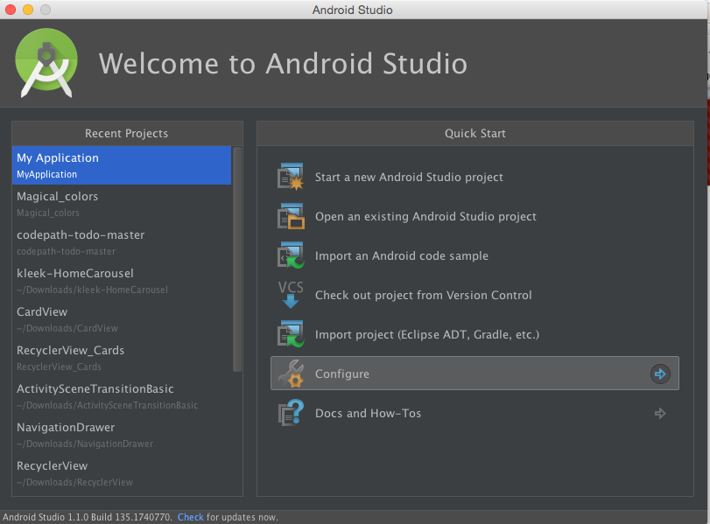
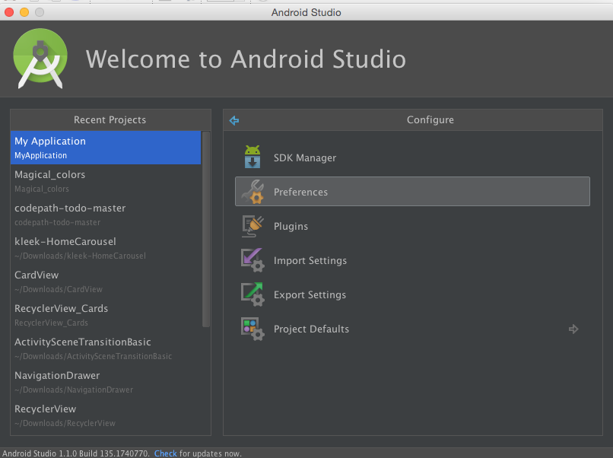
Studio Settings

Slide 9
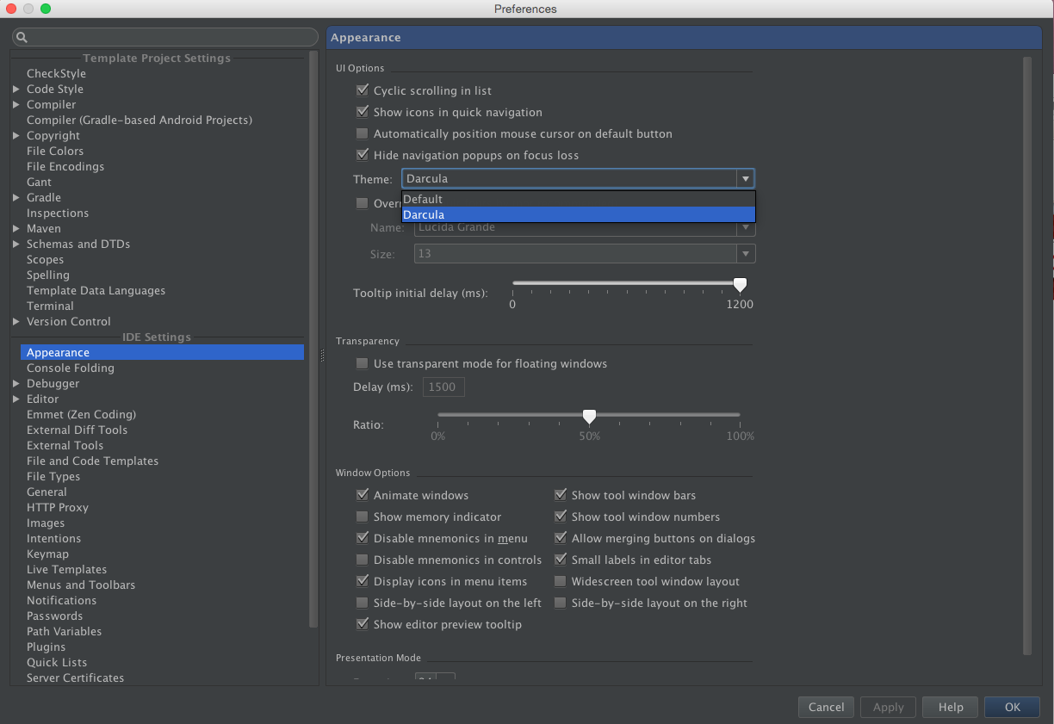
Features# Change Theme

Slide 10
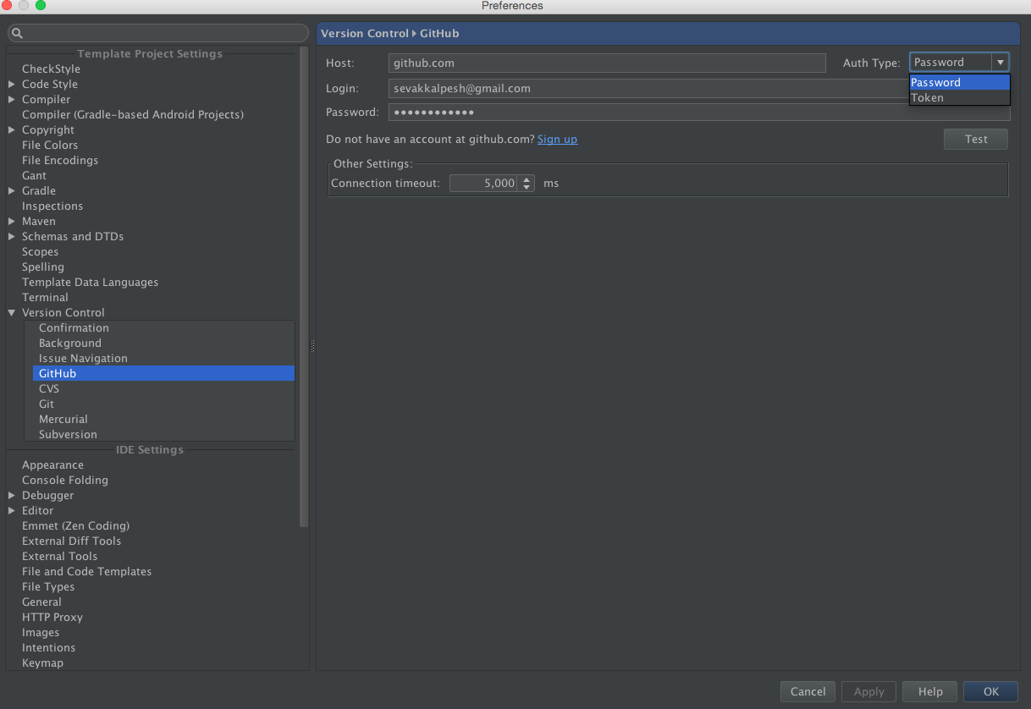
Features# Continuous Integration

Slide 11
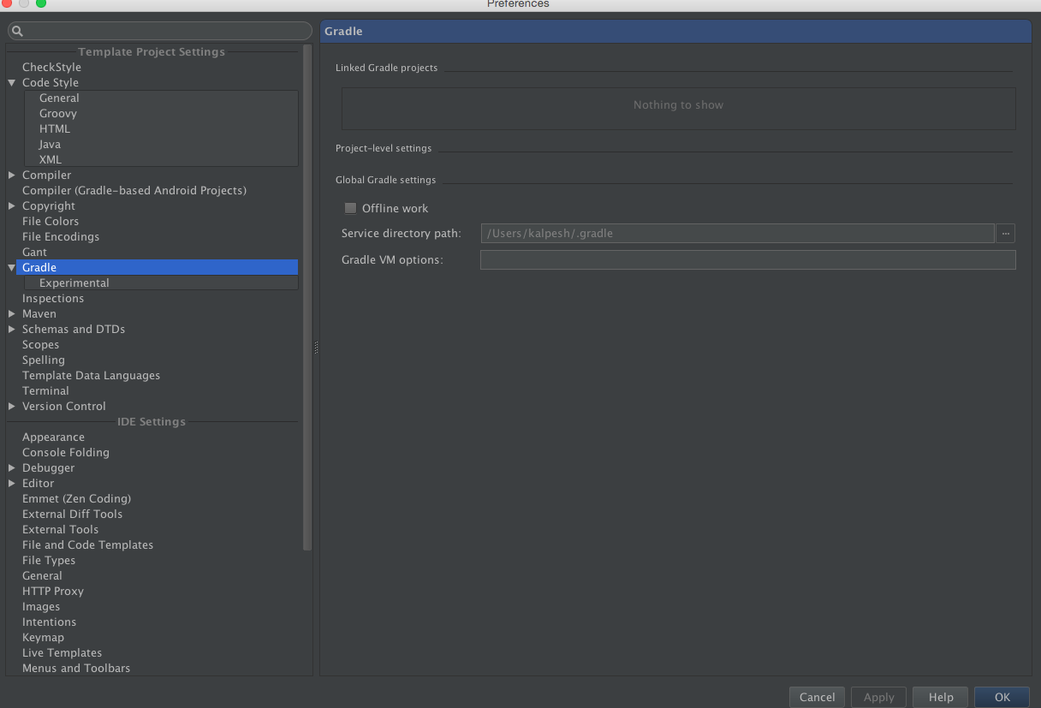
Features# Gradle Support

Slide 12
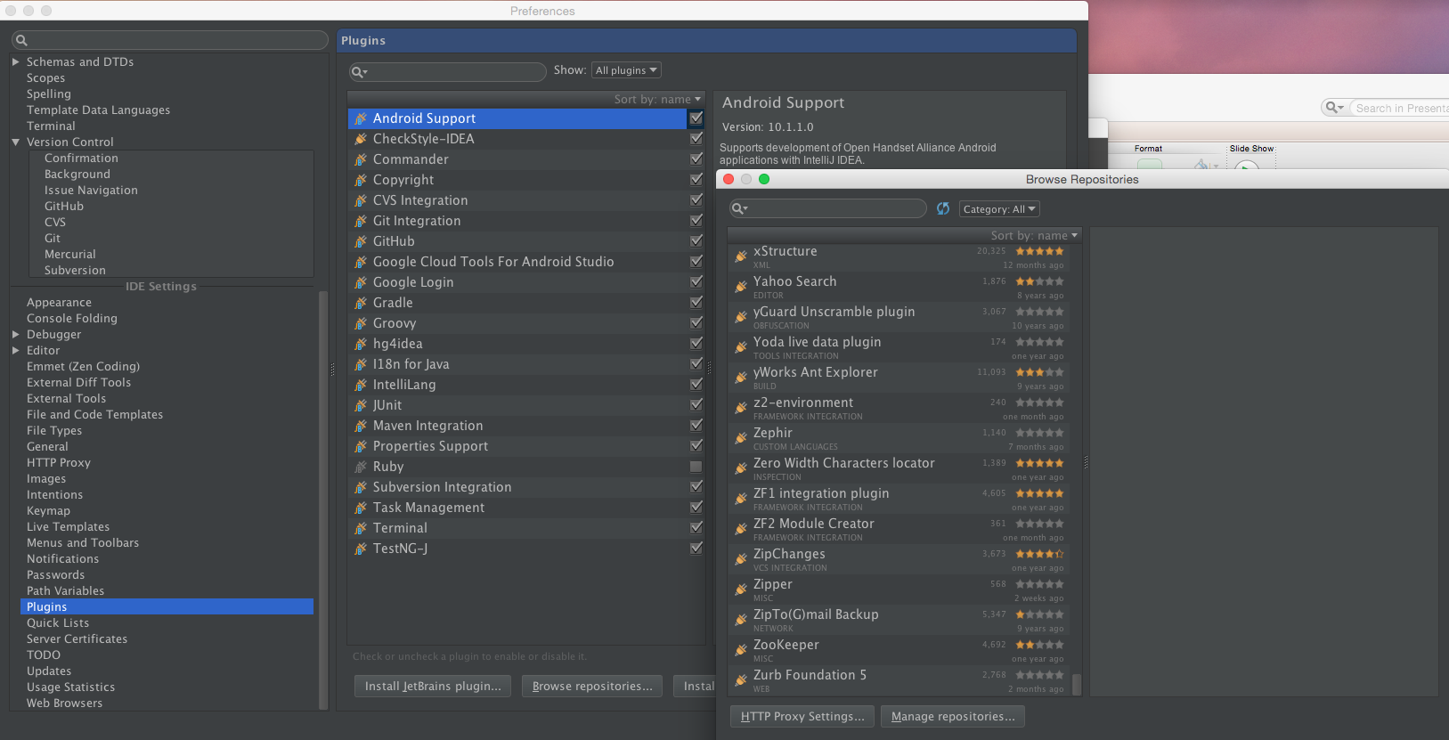
Features# Plugins Support

Slide 13
Building first App

Slide 14
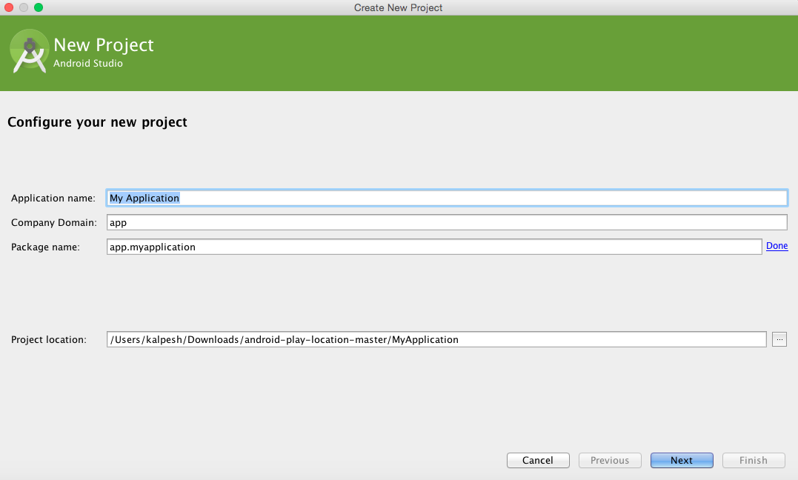
Step 1#
To create a new project, click File > New Project
Unique name to every package
Name on Play
Specific name
Location of project

Slide 15
Application_Config Details
Application Name
the app name that appears to users.
Project Name
the name of your project directory and the name visible in studio.
Package Name
the package namespace for your app (following the same rules as packages in the Java programming language).
Must be unique across all packages installed on the Android system.
It's generally best if you use a name that begins with the reverse domain name of your organization or publisher entity.
For this project, you can use something like "com.example.myfirstapp." However, you cannot publish your app on Google Play using the "com.example" namespace.

Slide 16
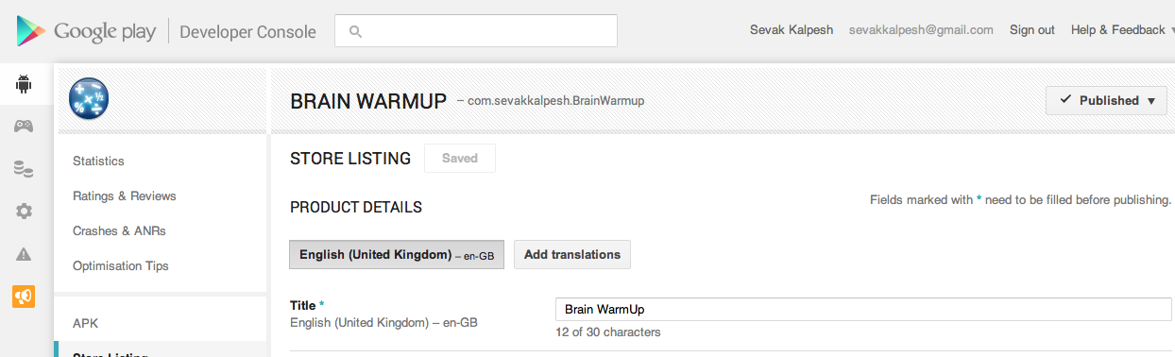
App on Google Play
1. Unique package name
2. All app on market have unique package name

Slide 17
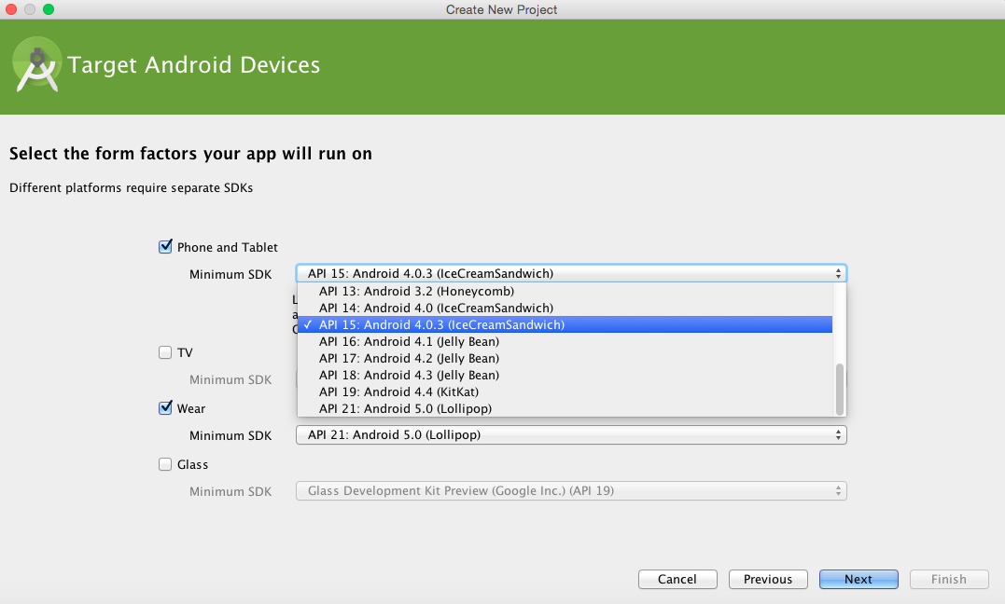
Step 2#
Select the API Level

Slide 18
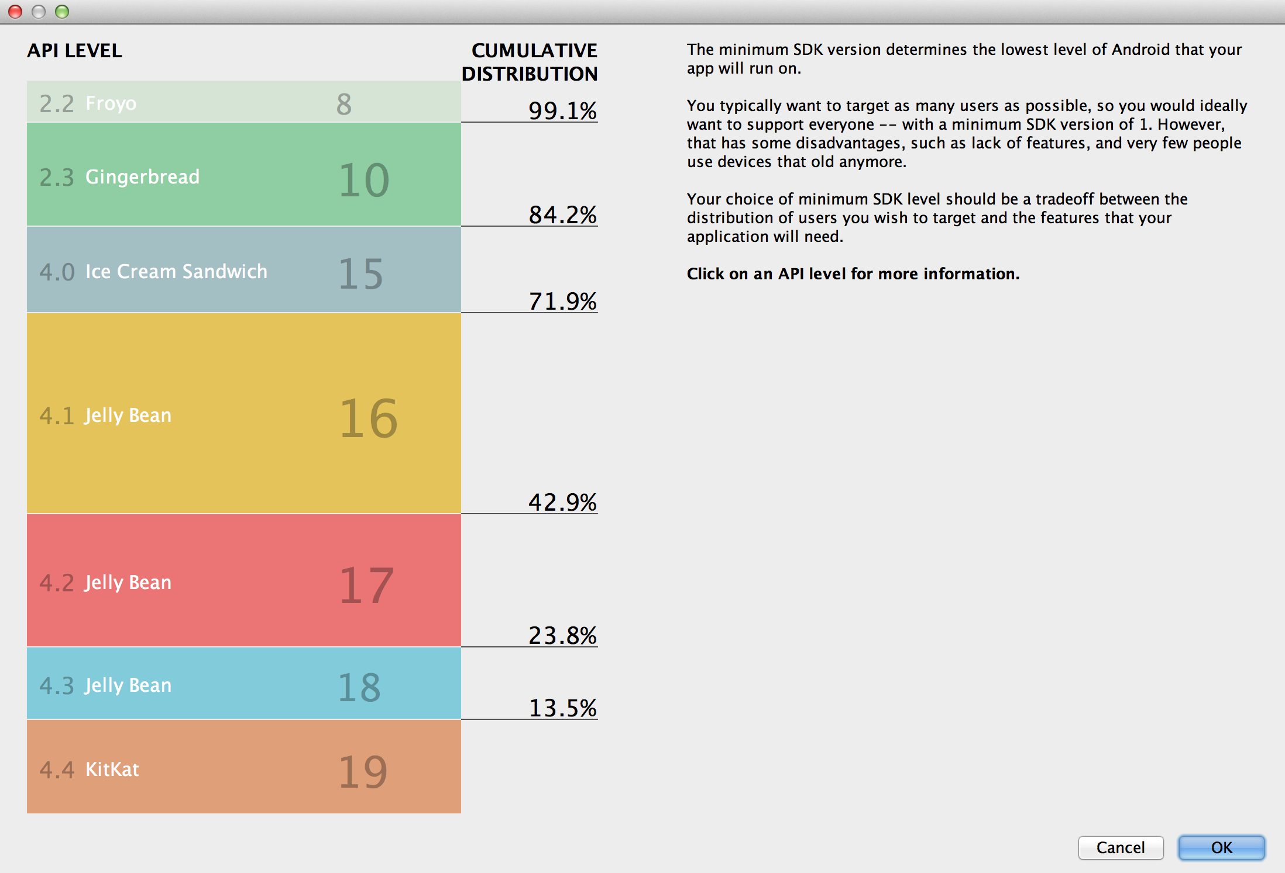
API Levels

Slide 19
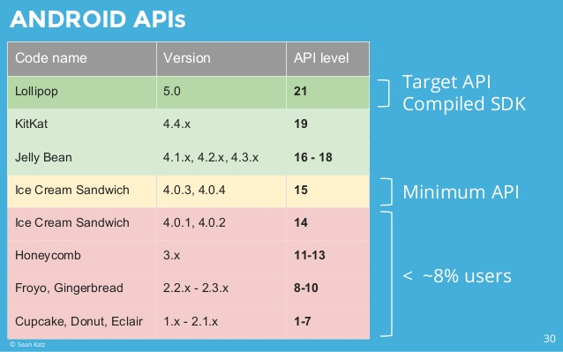
Which one to choose?

Slide 20
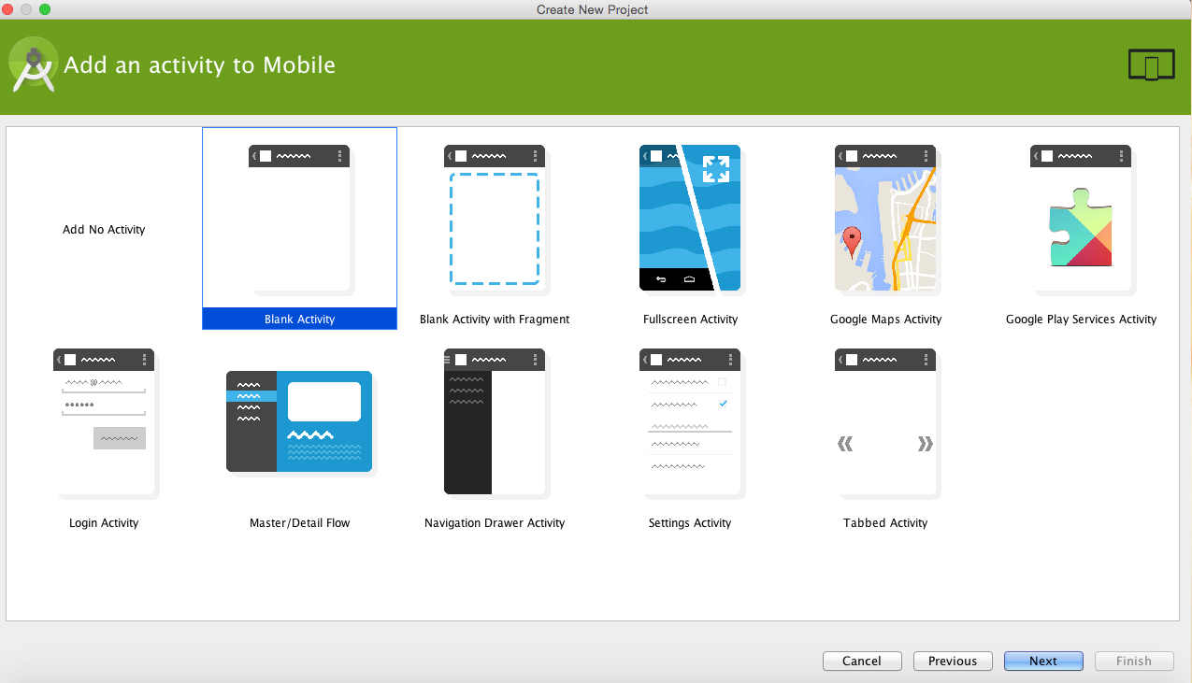
Step 3#
Select the template

Slide 21
Overview
There are several types of Android code templates, which can create anything from an entire application down to specific application components.
The main categories of code templates are as follows:
Application Templates
Activity Templates
Other Templates
Refer:
https://developer.android.com/tools/projects/templates.html#activity-templates

Slide 22
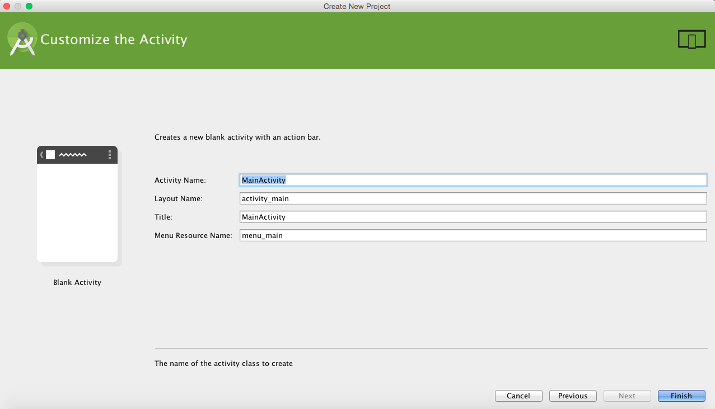
Step 4#
Specify the classname

Slide 23
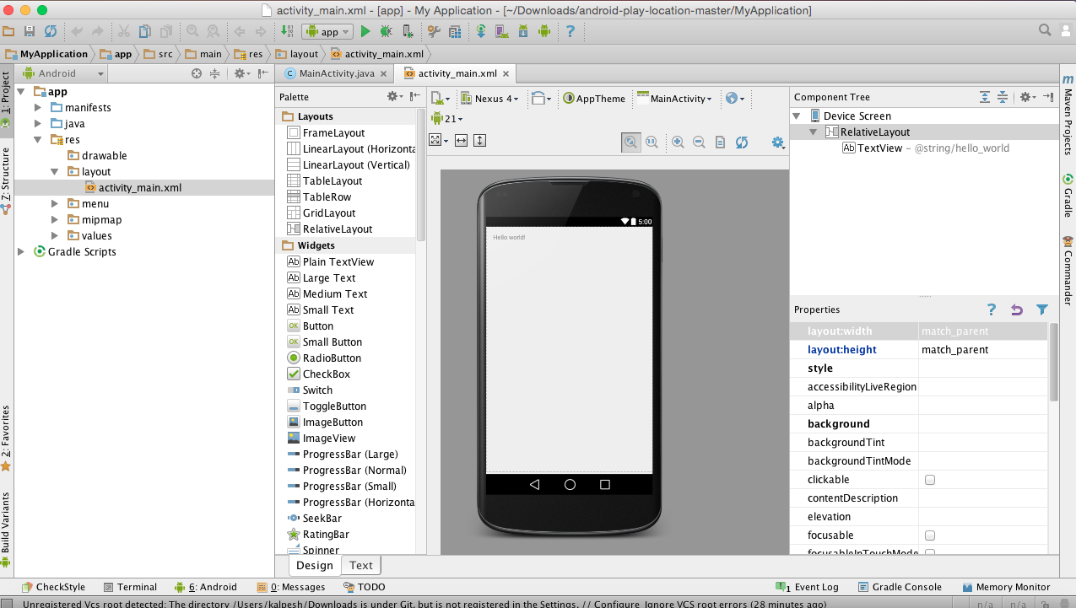
New project created

Slide 24
Running the App

Slide 25
AVD
Android Virtual Device
An Android Virtual Device (AVD) is an emulator configuration that lets you model an actual device by defining hardware and software options to be emulated by the Android Emulator.
You can create as many AVDs as you need, based on the types of device you want to model.
To thoroughly test your application, you should create an AVD for each general device configuration (for example, different screen sizes and platform versions) with which your application is compatible and test your application on each one.

Slide 26
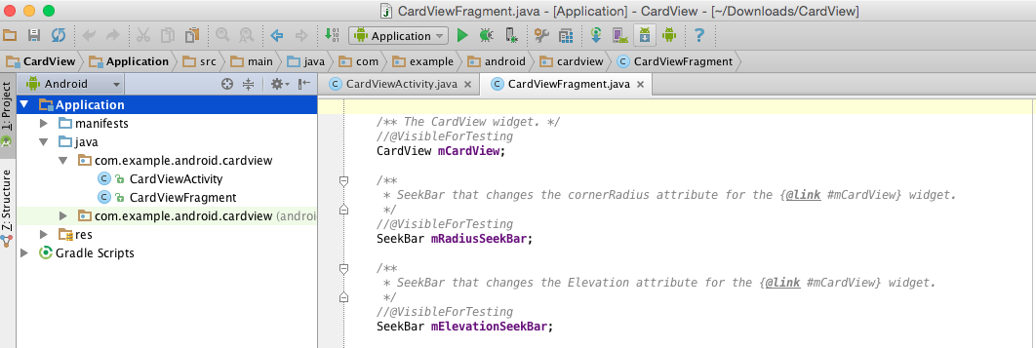
Options
Click on AVD Manager

Slide 27
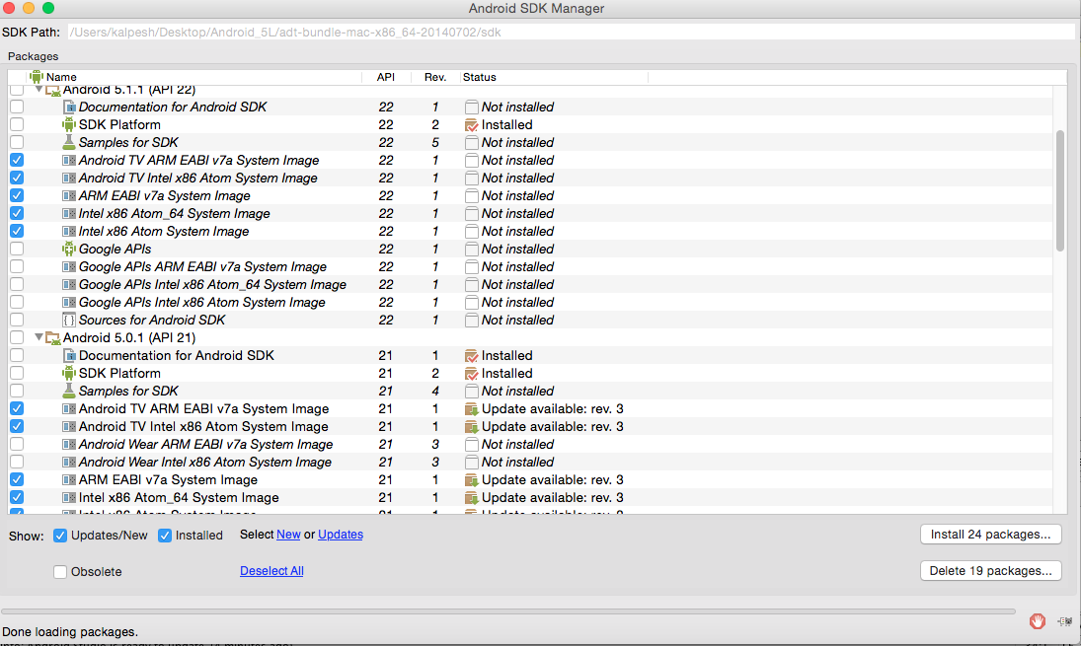
Options
Make sure that latest versions are installed

Slide 28
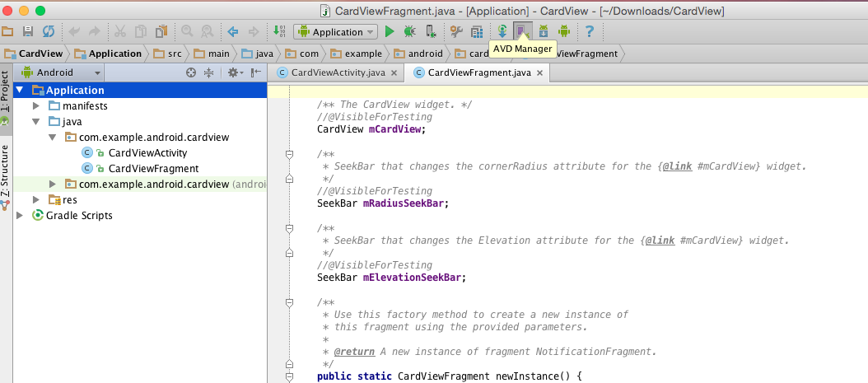
Options
Click on AVD Manager

Slide 29
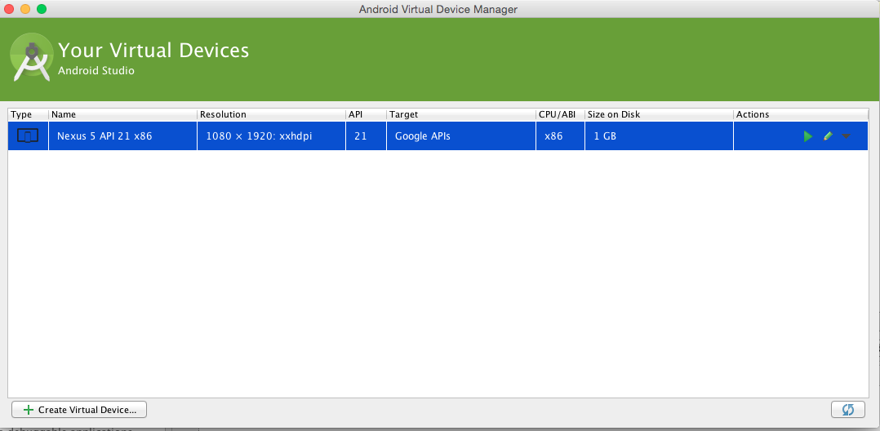
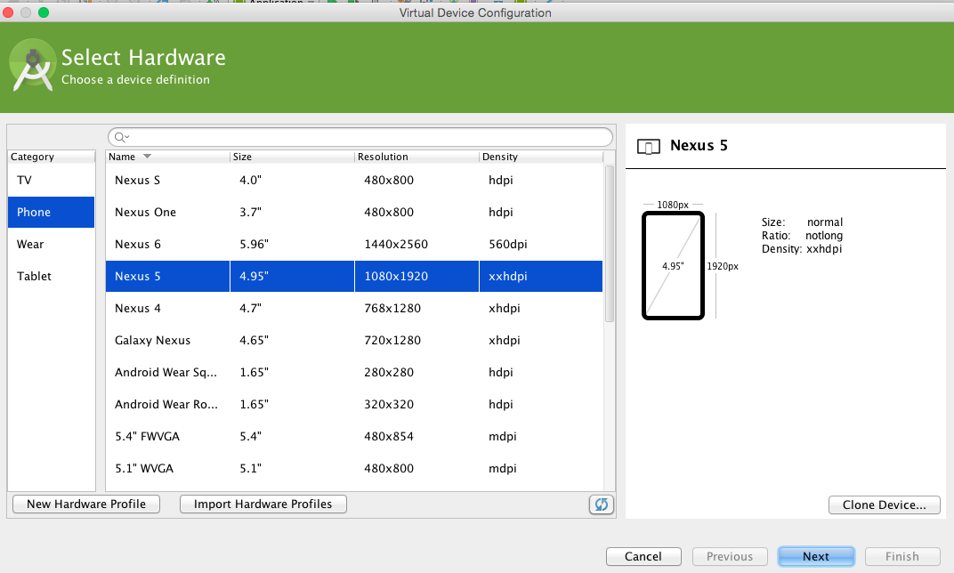
Options

Slide 30
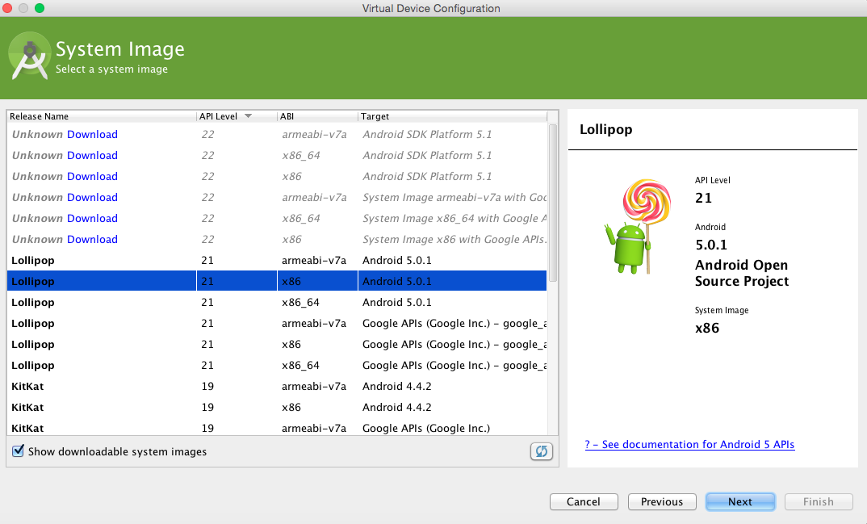
Options

Slide 31
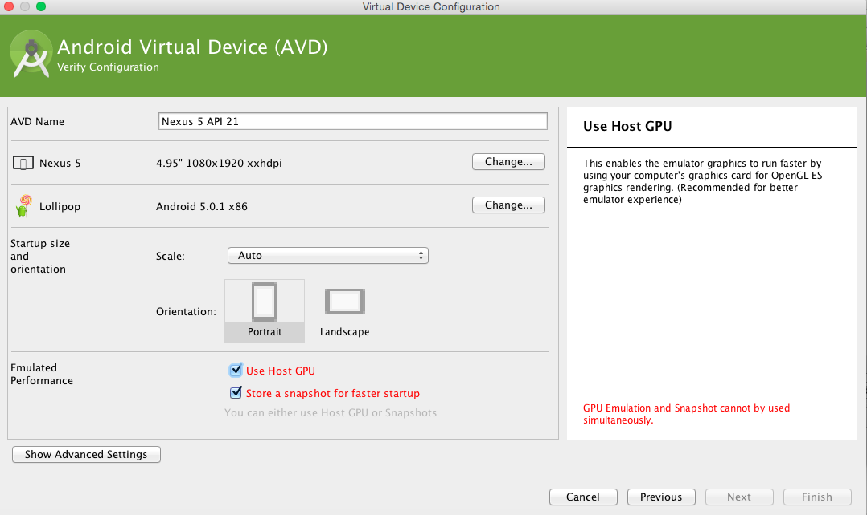
Options

Slide 32
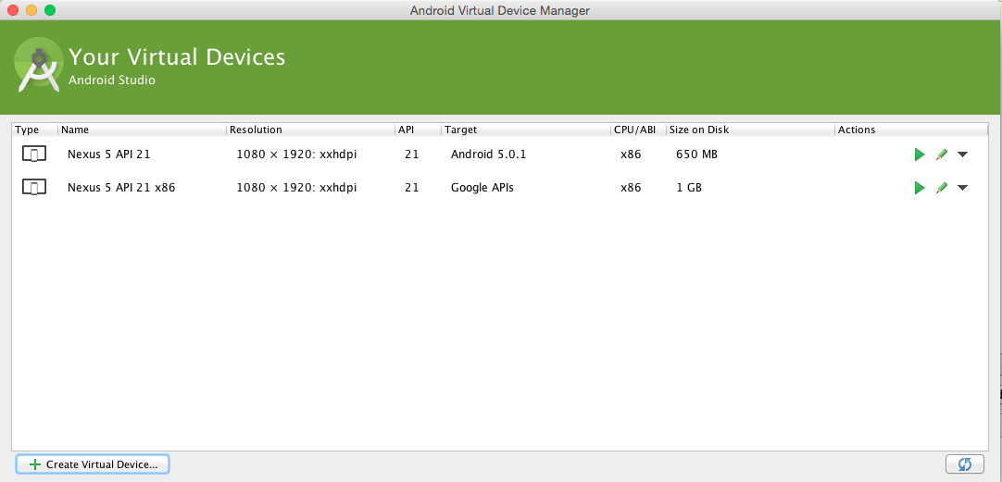
Options

Slide 33
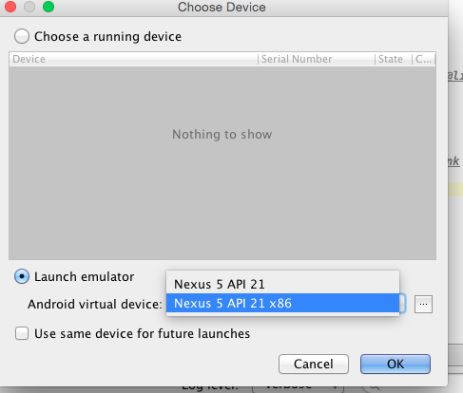
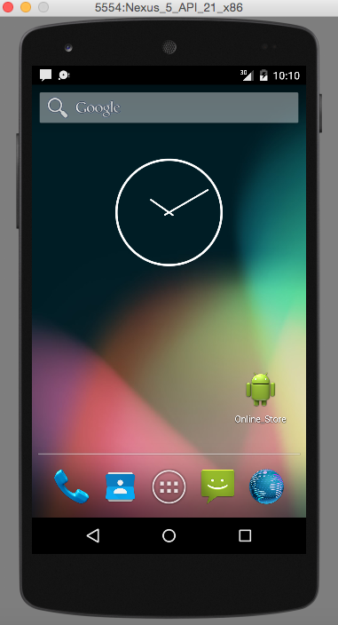
Options

Slide 34

Options
Best Android Emulator
https://cloud.genymotion.com/page/doc/

Slide 35
Managing Projects Overview

Slide 36
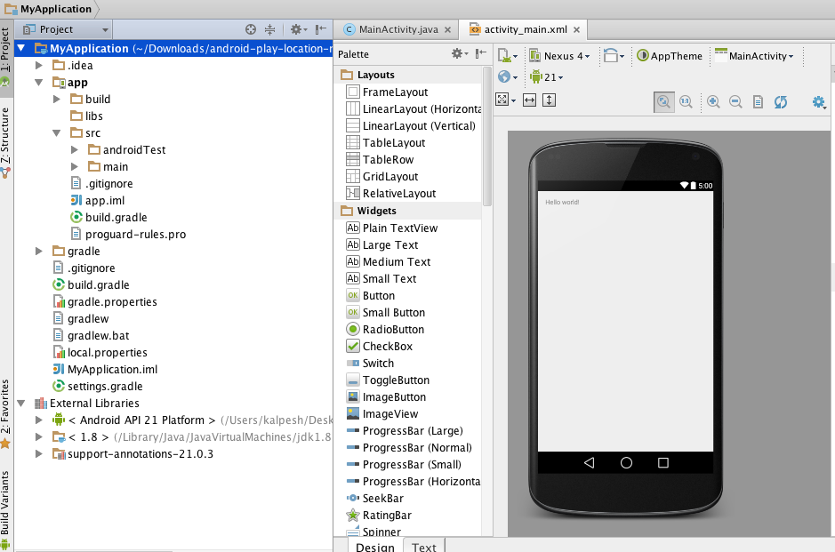
1# Android Application Module
Container for your application
Source code
Resource files
Application level settings,
Android Manifest file.

Slide 37
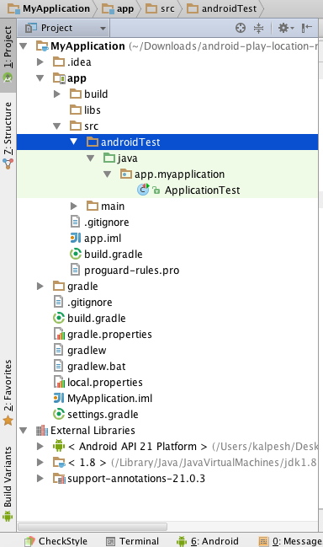
2# Test Module
These modules contain code to test your application projects and are built into test applications that run on a device
By default, Android Studio creates the androidTest module for
inserting JUnit tests.
Used for writing your test cases for your application.

Slide 38
3# Library Module
Contain shareable Android source code
Contains resources that you can reference in Android projects.
This is useful when you have common code that you
want to reuse.
Library modules cannot be installed onto a device

Slide 39
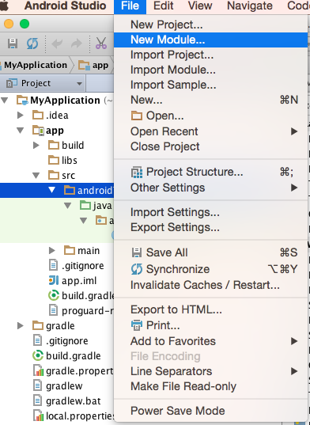
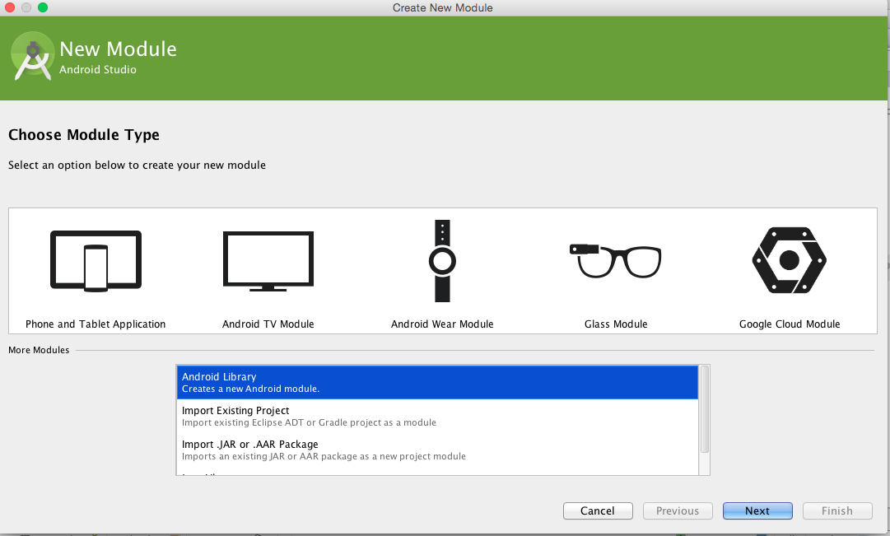
3# Library Module

Slide 40
Android Studio Project Structure

Slide 41
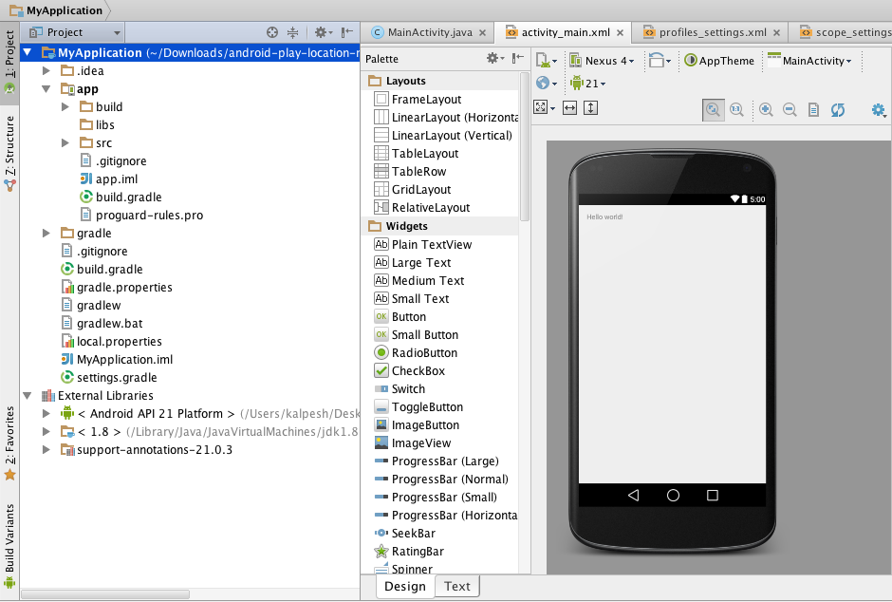
1# Project Module Overview
1
2
3
4

Slide 42
Overview
Filename | Details
.idea | Directory for IntelliJ IDEA settings.
app | Application module directories and files.
build | This directory stories the build output for all project modules.
gradle | Contains the gradler-wrapper files.
.gitignore | Specifies the untracked files that Git should ignore.
build.gradle | This file is integral to the project Customizable properties for the build system. You can edit this file to specify the default build settings used by the application modules Set the location of your keystore and key alias so that the build tools can sign your application when building in release mode.

Slide 43
Overview
Filename | Details
gradlew | Gradle startup script for Unix.
gradlew.bat | Gradle startup script for Windows.
local.properties | Customizable computer-specific properties for the build system, such as the path to the SDK installation. Because the content of the file is specific to the local installation of the SDK, the local.properties should not be maintained in a source revision control system.
.iml | Module file created by the IntelliJ IDEA to store module information.
settings.gradle | Specifies the sub-projects to build.
gradle.properties | Project-wide Gradle settings.

Slide 44
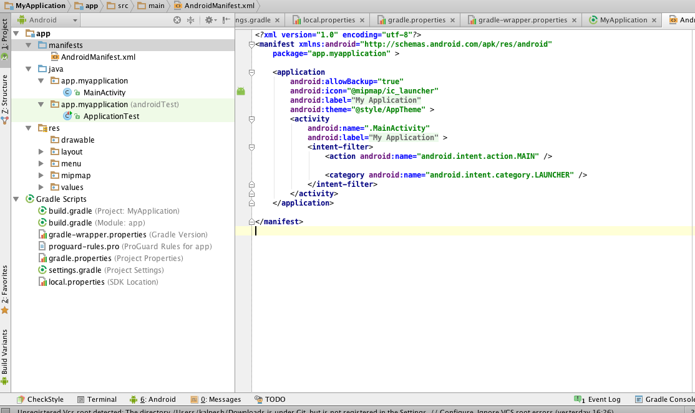
2# Application Module Overview
1
2
3
4

Slide 45
AndroidManifest.xml

Slide 46
AndroidManifest.xml
Declaring components
It describes the components of the application — the activities, services, broadcast receivers,
and content providers that the application is composed of.
It names the classes that implement each of the components and publishes their capabilities
(for example, which Intent messages they can handle).
These declarations let the Android system know what the components
are and under what conditions they can be launched.

Slide 47

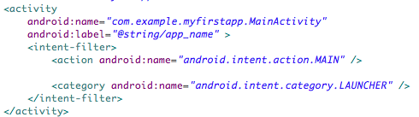
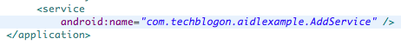
AndroidManifest.xml
Register activity if defined in .java
Register service if defined in .java
Register receiver if defined in .java

Slide 48
AndroidManifest.xml
Declaring Permissions
A permission is a restriction limiting access to a part of the code or to data on the device.
The limitation is imposed to protect critical data and code that could be misused to
distort or damage the user experience.
Often the label indicates the action that's restricted.
For example, here are some permissions defined by Android:
android.permission.CALL_EMERGENCY_NUMBERS android.permission.READ_OWNER_DATA android.permission.SET_WALLPAPER android.permission.DEVICE_POWER

Slide 49
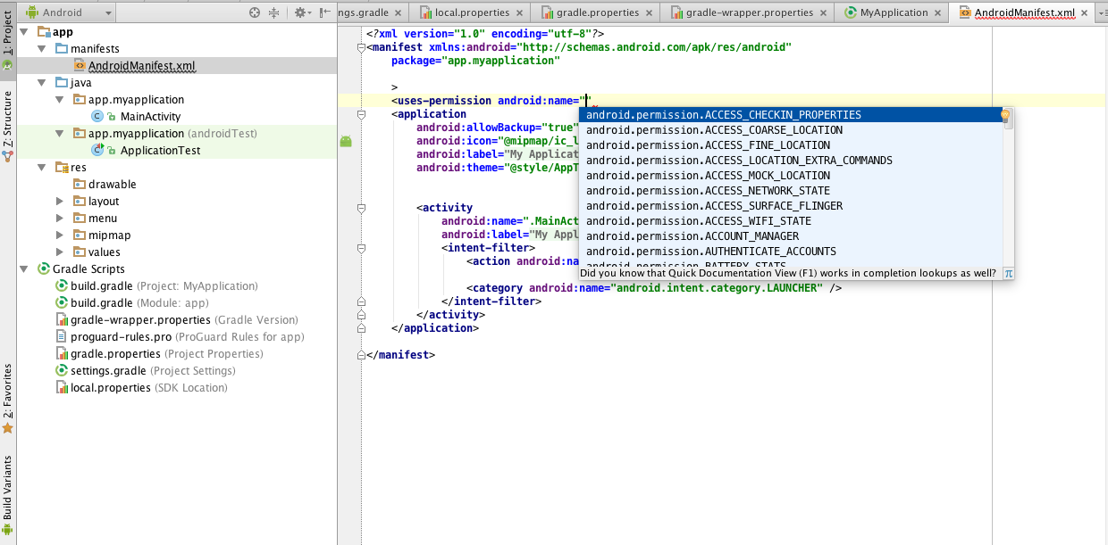
AndroidManifest.xml

Slide 50
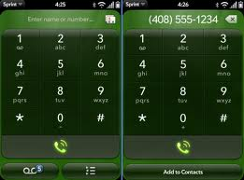
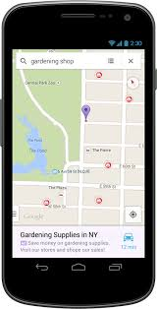
AndroidManifest.xml
Uses Internet and location_access permission
Uses dialer permission

Slide 51
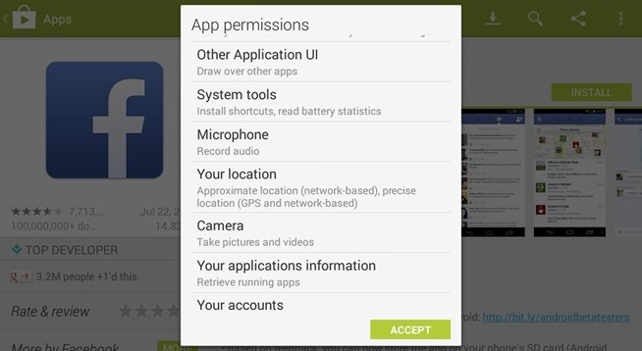
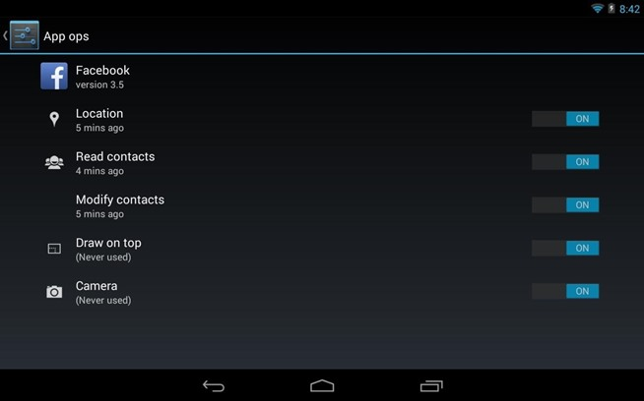
AndroidManifest.xml

Slide 52
AndroidManifest.xml
Defining Version Code and Name
A permission is a restriction limiting access to a part of the code or to data on the device.
android:versionName and android:versionCode specify the version of your application.
versionName is what the user sees and can be any string.
versionCode must be an integer.
The Android Market determines whether it should perform an update of the applications
for the existing installation based on that versionCode.
You typically start with "1" and increase this value by one if you roll-out a new version
of your application.

Slide 53
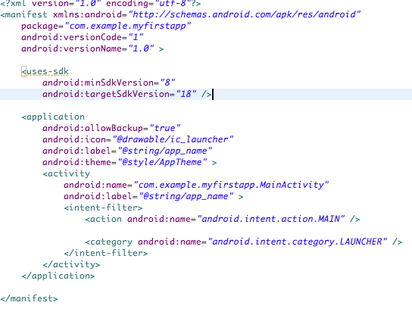
AndroidManifest.xml
Change it to “2” if app is to be again uploaded to android market only

Slide 54
AndroidManifest.xml
Change the Install location
Via the installLocation attribute of your application you can specify if your application
can be installed on the external storage of the device.
Use auto or preferExternal to permit this.
By default, the application is installed on the phone memory.
The property is set in the <manifest> tag.

Slide 55
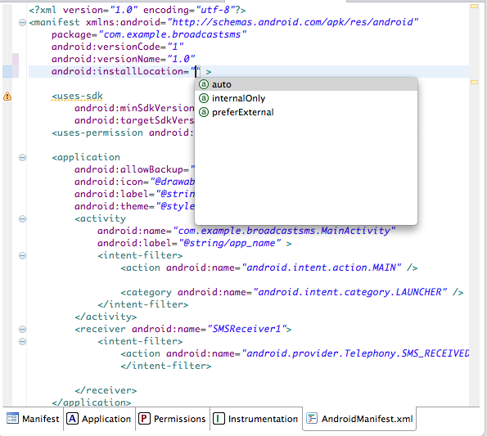
AndroidManifest.xml
Location where .apk will be installed

Slide 56
Configuring Gradle Builds

Slide 57
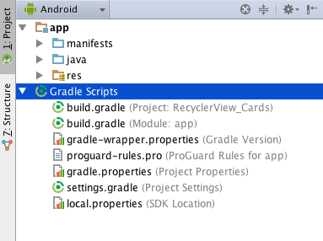
Build Configuration Basics
Android Studio projects contain a top-level build file and a build file for each module.
The build files are called build.gradle, and they are plain text files that use Groovy syntax to configure the build with the elements provided by the Android plugin for Gradle.
In most cases, you only need to edit the build files at the module level.

Slide 58
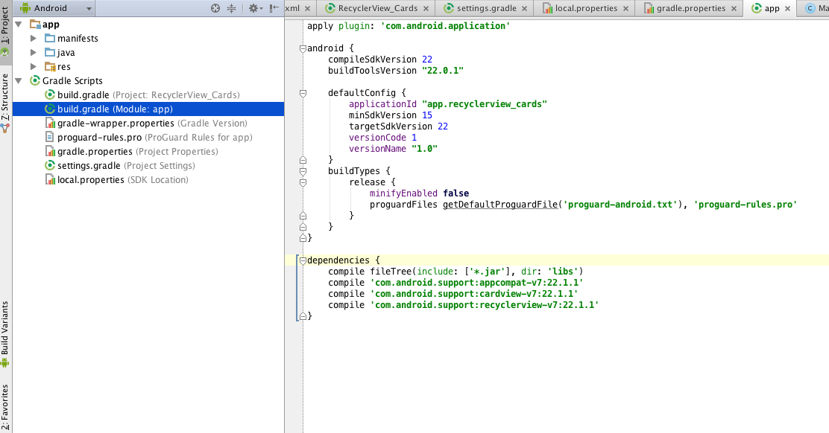
Module-Level gradle

Slide 59
Module-Level gradle attributes
apply plugin: 'com.android.application'
apply plugin: 'com.android.application' applies the Android plugin for Gradle to this build.
This adds Android-specific build tasks to the top-level build tasks and makes the android {...} element available to specify Android-specific build options.
android {...}
android {...} configures all the Android-specific build options:
The compileSdkVersion property specifies the compilation target.
The buildToolsVersion property specifies what version of the build tools to use. To install several versions of the build tools, use the SDK Manager.
Note: Always use a build tools version whose major revision number is higher or equal to that of your compilation target and target SDK.

Slide 60
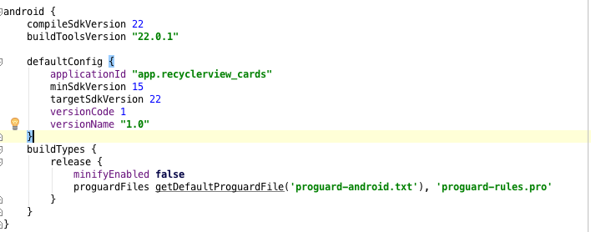
Module-Level gradle
Must be always equal or greater than target version
Unique app ID
Base API LEVEL for app to run
New app release track

Slide 61
Resource Shrinking
defaultConfig
The Gradle build system for Android supports "resource shrinking": the automatic removal of resources that are unused, at build time, in the packaged app.
In addition to removing resources in your project that are not actually needed at runtime, this also removes resources from libraries you are depending on if they are not actually needed by your application.
For example, your application is using Google Play Services to for example access Google Drive functionality, and you are not currently using Google Sign In, then this would remove the various drawable assets for the Sign In buttons.
Note that resource shrinking only works in conjunction with code shrinking (such as ProGuard).
That's how it can remove unused resources from libraries; normally, all resources in a library are used, and it is only when we remove unused code that it becomes apparent which resources are referenced from the remaining code.

Slide 62
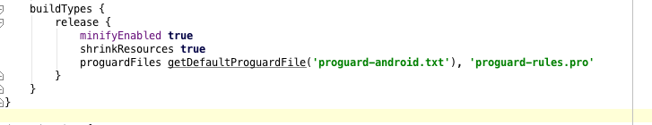
Resource Shrinking
Code-shrinking
Resource-shrinking
If you have not already been using minifyEnabled, make sure you get that working before also adding shrinkResources, since you may have to edit your proguard-rules.pro file to make sure any methods you access with reflection etc are listed as keep rules in that file.
Check deleted resource
$ ./gradlew clean assembleDebug --info | grep "Skipped unused resource"
Skipped unused resource res/anim/abc_fade_in.xml: 396 bytes
Skipped unused resource res/anim/abc_fade_out.xml: 396 bytes
Skipped unused resource res/anim/abc_slide_in_bottom.xml: 400 bytes
Skipped unused resource res/anim/abc_slide_in_top.xml: 400 bytes
Skipped unused resource res/anim/abc_slide_out_bottom.xml: 400 bytes

Slide 63
Declare dependencies
dependencies
Module dependencies
The app module depends on the lib module, because MainActivity launches LibActivity1 as described in Open an Activity from a Library Module.
compile project(":lib") declares a dependency on the lib module of BuildSystemExample. When you build the app module, the build system assembles and includes the lib module.
Remote binary dependencies
The app and lib modules both use the ActionBarActivity class from the Android Support Library, so these modules depend on it.
compile 'com.android.support:appcompat-v7:19.0.1' declares a dependency on version 19.0.1 of the Android Support Library by specifying its Maven coordinates.

Slide 64
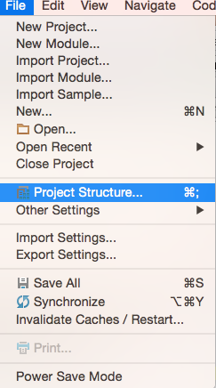
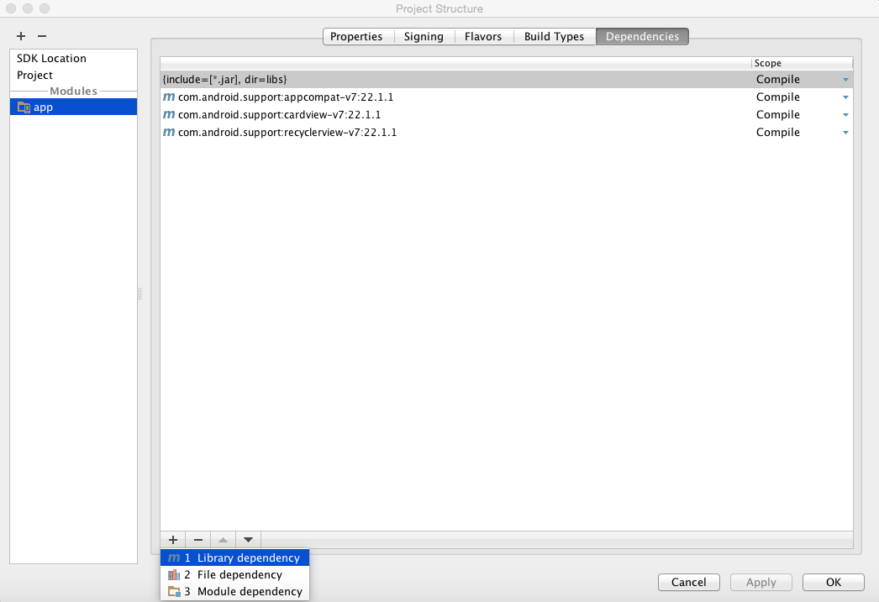
Remote

Slide 65
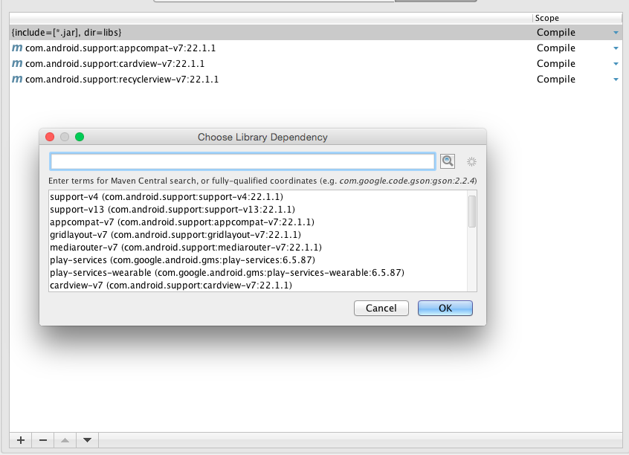
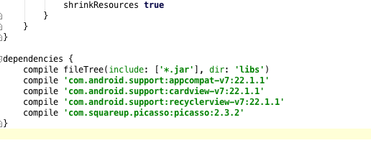
Remote

Slide 66
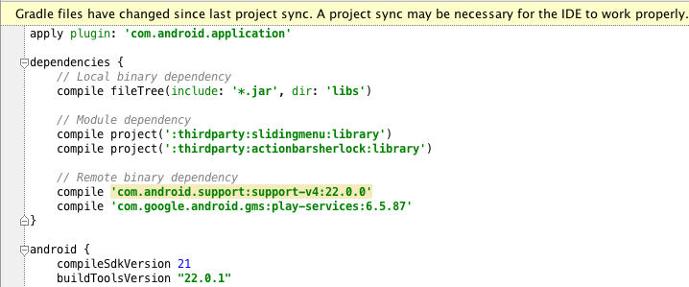
Declare dependencies
dependencies
dependencies {
// Module dependency
compile project(":lib")
// Remote binary dependency
compile 'com.android.support:appcompat-v7:19.0.1'
// Local binary dependency
compile fileTree(dir: 'libs', include: ['*.jar'])
}

Slide 67

Library Dependenies
dependencies

Slide 68

Local dependencies
Local binary dependencies
Some modules do not use any binary dependencies from the local file system. If you have modules that require local binary dependencies, copy the JAR files for these dependencies into <moduleName>/libs inside your project.
compile fileTree(dir: 'libs', include: ['*.jar']) tells the build system that any JAR file inside app/libs is a dependency and should be included in the compilation classpath and in the final package.

Slide 69
What is ProGuard?
The ProGuard tool shrinks, optimizes, and obfuscates your code by removing unused code and renaming classes, fields, and methods with semantically obscure names.
The result is a smaller sized .apk file that is more difficult to reverse engineer. Because ProGuard makes your application harder to reverse engineer, it is important that you use it when your application utilizes features that are sensitive to security like when you are Licensing Your Applications.
ProGuard is integrated into the Android build system, so you do not have to invoke it manually.
ProGuard runs only when you build your application in release mode, so you do not have to deal with obfuscated code when you build your application in debug mode.
Having ProGuard run is completely optional, but highly recommended.

Slide 70

App gradle File
Updated gradle:number
Problems when you imported projects

Slide 71
Resources

Slide 72
Resources
Resources, like images and XML configuration files, are kept separate from the source code in Android applications.
Resource files must be placed in the /res directory in a predefined sub-folder.
The specific sub-folder depends on type of resource which is stored.
The following table gives an overview of the supported resources and their standard folder prefixes.
Important resources:
Drawable
Values( strings.xml, styles.xml, dimens.xml)
Layout
menu

Slide 73
Resources
Resources | Folder | Description
Drawable | /res/drawable | Images (e.g., png or jpeg files) or XML files which describe a Drawable object.
Simple Values | /res/values | Used to define strings, colors, dimensions, styles and static arrays of strings or integers via XML files. By convention each type is stored in a separate file, e.g., strings are defined in the res/values/strings.xml file.
Layouts | /res/layout | XML files with layout descriptions are used to define the user interface for Activities and fragments.

Slide 74
Resources
Resources | Folder | Description
Styles and Themes | /res/values | Files which define the appearance of your Android application.
Animations | /res/animator | Defines animations in XML for the animation API which allows to animate arbitrary properties of objects over time.
Menus | /res/menu | Defines the properties of entries for a menu.

Slide 75

Resources
Set the values to xml
Properties window

Slide 76

1# Strings.xml
Strings
Set Color
Arrays

Slide 77

Color Options
http://www.google.co.uk/design/spec/style/color.html#color-color-palette

Slide 78
1# Strings.xml

Slide 79

2#Images: drawable and mipmap
Should be used only to place app icons

Slide 80

2#Images: drawable and mipmap
Place background images, other icons

Slide 81
Check your assets
Some device has a quantized density of 560 dpi, which falls in between the xxhdpi and xxxhdpi primary density buckets.
For the Nexus 6, the platform will scale down xxxhdpi assets, but if those aren’t available, then it will scale up xxhdpi assets.
Provide at least an xxxhdpi app icon because devices can display large app icons on the launcher.
It’s best practice to place your app icons in mipmap- folders (not the drawable- folders) because they are used at resolutions different from the device’s current density.
For example, an xxxhdpi app icon can be used on the launcher for an xxhdpi device.

Slide 82
The Process

Slide 83

Create JAVA FILE
Connect logic to layout

Slide 84

Create layout XML

Slide 85

Declare in Manifest
Register the class

Slide 86
Association
XML
JAVA
setContentView()
MANIFEST

Slide 87
DCR PROCESS
Step 1# DESIGN : Create all the designing xml files for different screens.
Step 2# CODING :
2.1 Join the xml file to the java file .
2.2 Build the programming logic.
Step 3# REGISTRATION : Register your java file .

Slide 88
Android Quickstart
Sample App

Slide 89


Sample Output

Slide 90

Drag and DROP the button the layput

Slide 91
XML file
<RelativeLayout xmlns:android="http://schemas.android.com/apk/res/android"
xmlns:tools="http://schemas.android.com/tools"
android:layout_width="match_parent"
android:layout_height="match_parent"
android:id="@+id/relative"
>
<Button
android:id="@+id/button1"
android:layout_width="wrap_content"
android:layout_height="wrap_content"
android:layout_alignParentTop="true"
android:layout_centerHorizontal="true"
android:layout_marginTop="146dp"
android:text="Magic Colors" />
</RelativeLayout>
Every View has Unique ID

Slide 92
R.java
public static final class id {
public static final int action_settings=0x7f080002;
public static final int button1=0x7f080001;
public static final int relative=0x7f080000;
}
public static final class layout {
public static final int activity_main=0x7f030000;
}
Every View has Unique binary id

Slide 93
Create object
public class MainActivity extends Activity {
//Step 1 create objects
RelativeLayout rl;
Button btn;
@Override
protected void onCreate(Bundle savedInstanceState) {
super.onCreate(savedInstanceState);
setContentView(R.layout.activity_main);
Two Objects as will use
Button and Relative layout

Slide 94
Connect id to objects
public class MainActivity extends Activity {
//STEP 1 : CREATE OBJECTS
RelativeLayout relScreen;
Button btnChange;
@Override
protected void onCreate(Bundle savedInstanceState) {
super.onCreate(savedInstanceState);
setContentView(R.layout.activity_main);
//STEP 2 : CONNECT OBJECTS TO ID
relScreen=(RelativeLayout)findViewById(R.id.rel);
btnChange=(Button)findViewById(R.id.button1);

Slide 95
DCR PROCESS
Connect Objects to ID
R.id.btn1
Button1
ID=btn1
R.java
setContentView(R.layout.main);
main.xmll

Slide 96
Click Events
//STEP 3 : CLICK EVENT
btnChange.setOnClickListener(new View.OnClickListener() {
@Override
public void onClick(View arg0) {
// TODO Auto-generated method stub
Random color=new Random();
relScreen.setBackgroundColor(Color.argb(255, color.nextInt(255), color.nextInt(255), color.nextInt(255)));
}
});
}

Slide 97
Output

Slide 98
Android Quickstart
Building a Todo Application
(with Android Studio)

Slide 99


Todo App - Simple & Functional
Best way to learn is to build!
We’ll look at the essentials for apps
We’ll build a simple Todo List

Slide 100
Scoping the Todo App
View a list of existing items
Add a new item
Remove an item
For this application we need just one screen which mean a single Activity.
(Bonus: future versions could enable marking completion or setting priorities.)

Slide 101

Create New Android Project

Slide 102

Select Platform and Version

Slide 103

Select “Blank Activity”

Slide 104

Configure “MainActivity”

Slide 105

Configure Imports
Set “Imports on Paste” to “All”
Check “Add unambiguous imports on the fly”

Slide 106

Open activity_main.xml
Click on the second tab to reveal the XML file

Slide 107


Give it a Run on a Device or in the Emulator

Slide 108
Android Framework Orientation
Activity
==
1 UI Screen
src/res/
layout
==
Look
src/main/
*.java
==
Behavior

Slide 109
Anatomy of Android App
Anatomy of an Android App
ToDo Activity (Screen)
Settings Activity (Screen)
Layout and Look in res/layout/activity_todo.xml
Layout and Look in res/layout/
activity_settings.xml
Launches
Behavior and Logic in src/main/ToDoActivity.java
Behavior and Logic in src/main/SettingsActivity.java

Slide 110

Wireframe the Todo App
Basic interface:
A
(A) Basic Label with App Name
(B) Basic List of Items
Vertically Scrollable
Hold Down to Remove Item
(C) Adding items with Textbox and Button
B
C

Slide 111

Build the Interface, Pt 1
1. Click on “Hello World” label and press the backspace key to remove.
2. Drag a Button from left-hand side (Widgets) to Bottom-Right of Layout
Note: When dragging views onto layout, ensure green lines confirm location before releasing.

Slide 112

Build the Interface, Pt. 2
Drag More Views onto Layout
1. Text Fields → Plain Text
Drag to Bottom-Left
Resize Right Side to Button
2. Containers → ListView
Drag to Top Left Corner
Resize Bottom Above Button
Note: When dragging new views to layout, ensure green lines confirm location before releasing.

Slide 113

Build the Interface
Assign Hint to EditText
Double-click on view to assign ID
ListView = lvItems
EditText = etNewItem
Button = btnAddItem

Slide 114

Visual UI Builder Automatically Generates XML
Every action was translated into XML
All three views are wrapped in a "Layout"
All three views have listed properties (id, height, width, etc.)

Slide 115


Give it a Run on a Device or in the Emulator

Slide 116

Code Basic Behavior
Code in the Java source file for this activity.
The XML layout for this activity is applied in onCreate()
Every Activity extends from the same base class
This is where we add our application logic

Slide 117

Create List of Items and Display in ListView
Create an ArrayList
Create an ArrayAdapter
Get a handle to ListView
Attach adapter to ListView
An adapter allows us to easily display the contents of an ArrayList within a ListView.

Slide 118


Give it a Run on a Device or in the Emulator

Slide 119


Add Items to the List
Add "onClick" property to Button in XML
Create onAddItem() method to MainActivity.java which adds input item to the list

Slide 120

Remove Items from List
Create method for setting up the listener
Invoke listener from onCreate()
Attach a LongClickListener to each Item for ListView that:
Removes that item
Refreshes the adapter

Slide 121

Methods for Loading and Saving Items from a File
Create method to open a file and read a newline-delimited list of items
Create method to save a file and write a newline-delimited list of items
Important! FileUtils is in a library called Apache Commons IO which we need to download and import by dragging the jar into the “libs” folder of our app directory. Next, right-click to “As as Library…” and do a Gradle Sync.

Slide 122



Invoking Methods to Load and Save Files
Load items during onCreate()
Save items when a new list item is added
Save items when a list item is removed
Note: Be sure to remove items = new ArrayList<String>(); from onCreate when adding the call to readItems(); and also be sure to remove the “test items” being added every time.

Slide 123

Run the Final Todo App

Slide 124
ToDo App Summary
Congratulations! You have built your very first functioning application using many essential concepts:
Activity XML (Layouts and Views)
Activity Source (Java Code for App Logic)
View IDs and Properties
ListViews, EditText and Button View Types
List Adapters for Displaying List Items
Click Handling for Buttons and List Items
Testing Applications with the Emulator
What you would add to the ToDo List next?

Slide 125


Slide 126
Understanding ViewGroup
Layouts

